Slide 1
IOT CAR ROBOT
Submitted by :
Sankuri vamshi
ECE - 221910401040
Guided by :
Prof. Havilah

Slide 2
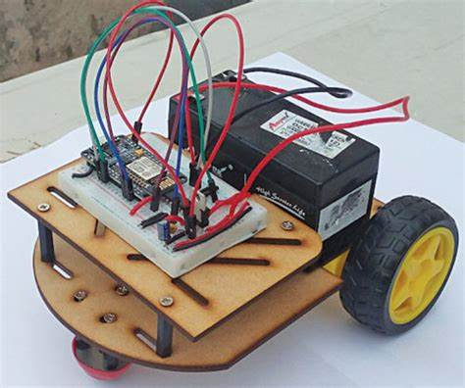
Project I worked on
Simple IOT robot:
In this project, we will make an iot based wireless wi-fi robot car using the node
MCU esp8266-12e wi-fi board with the l298n motor driver module.
We will interface this wi-fi car with mert arduino application in which by entering the ip address, you can control by giving the directional command using the smartphone.

Slide 3
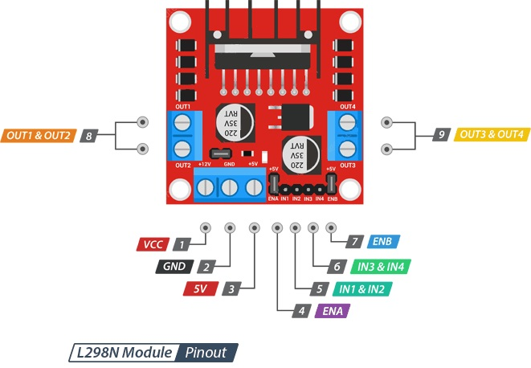
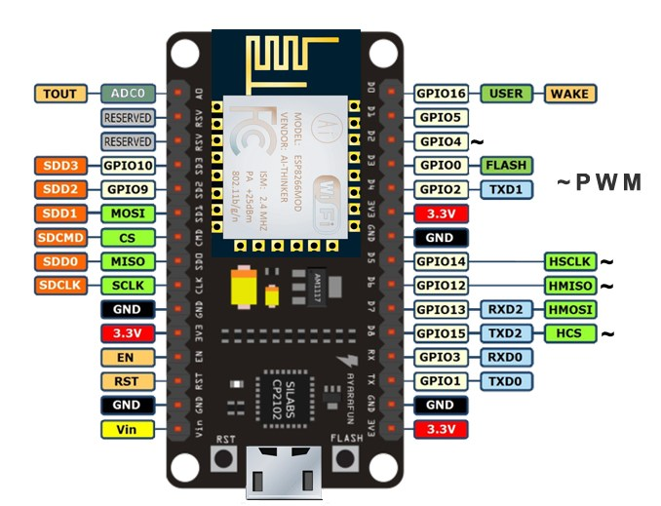
Specifications
L298N motor driver module
The L298N is a dual-channel H-Bridge motor driver capable of driving a pair of DC motors. That means it can individually drive up to two motors making it ideal for building two-wheel robot platforms.
NodeMCU ESP8266 CP2102 NodeMCU WIFI Serial Wireless Module
ESP8266 CP2102 NodeMCU LUA ESP-12E WIFI Serial Wireless Module
Built-in Micro-USB, with flash and reset switches, easy to program

Slide 4
Components
Node MCU -1 with cable
L2930 motor driver module-1
Wheel Robot chains-1
Rocker switch-1
mini bread board-1
3.7V ,2200mh Li-Po batteries-3
3.7V, 2200mh case-1
Male to Male-15
Male to Female - 10,
Female to Female -10

Slide 5
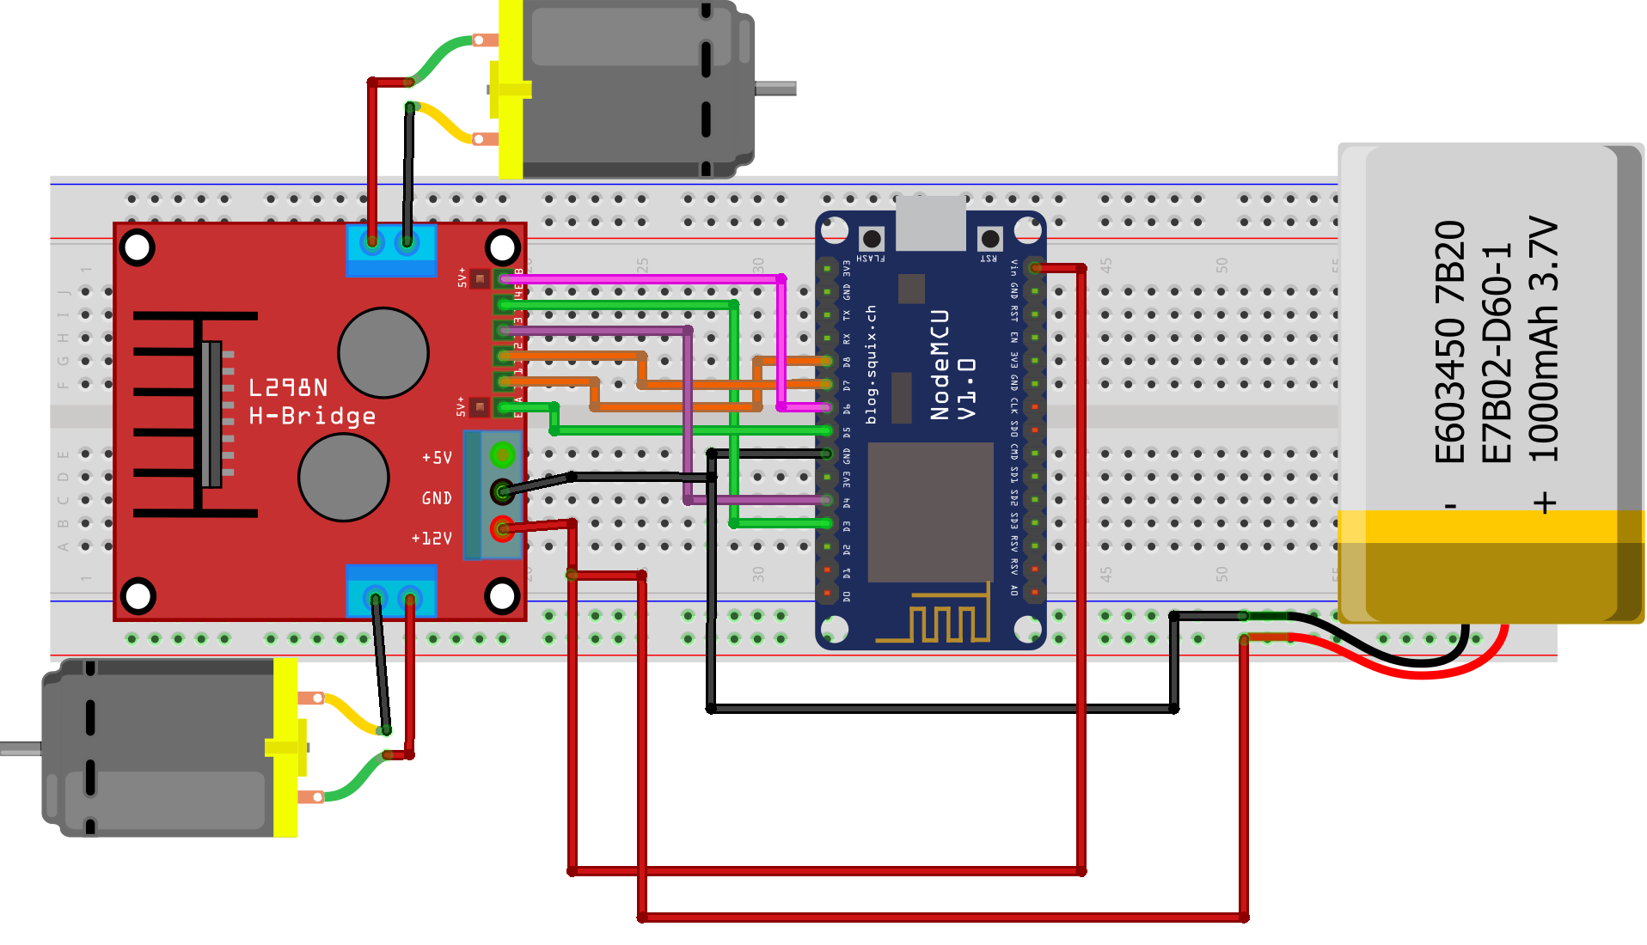
Circuit connections
Connect the ENA pin of the L298N Motor Driver module to D5 pin of the NodeMCU board.
Connect ENB pin of L298N Motor Driver Module to D6 pin of NodeMCU board.
Connect the IN1 pin of the L298n motor driver module to the D8 pin of the NodeMCU board.
Connect the IN2 pin of the L298n motor driver module to the D7 pin of the NodeMCU board.
Connect the IN3 pin of the L298n motor driver module to the D4 pin of the NodeMCU board.
Connect the IN4 pin of the L298n motor driver module to the D3 pin of the NodeMCU board.
Connect the GND pin of the L298n motor driver module to the GND pin of the NodeMCU board.
Connect VCC pin of L298n motor driver module to Vin pin of NodeMCU board.

Slide 7

Working And Output
After uploading the code, open the application.
The wi-fi address for the phone and board should be the same.
The operating system of the smart mobile phone in android we develop a remote control program. The program connected with wi-fi to communicate with the robot. Wireless control is the most important basic needs of all people. Wireless network-controlled robots use wi-fi modules.
Arduino blue control android application will transmit command using wi-fi to the car so that it can move in the required direction like moving forward, reverse, turning left, turning right and stop.

